Slide 1
Requirements Elaboration
Understanding and analyzing what needs to be built

Slide 2
Elaboration
Some Analysis Techniques
Data Flow Diagram (DFD)
Usecase Diagram
Object Models (ER Diagram, Abstract class diagram, CRC cards)
Decision Tables
State Diagram (Statecharts)
Sequence Diagrams (Message Sequence Charts)
Activity Diagram
Swim-lane Diagram
Flow-oriented, Scenario-based, Class-based, Behavioral

Slide 3
Use Case Diagram (Recap)
Components
A large box: system boundary
Stick figures outside the box: actors, both human and systems
Each oval inside the box: a use case that represents some major required functionality and its variant
A line between an actor and use case: the actor participates in the use case
Use cases do not necessarily model all the tasks, instead they are used to specify user views of essential system behaviour

Slide 4
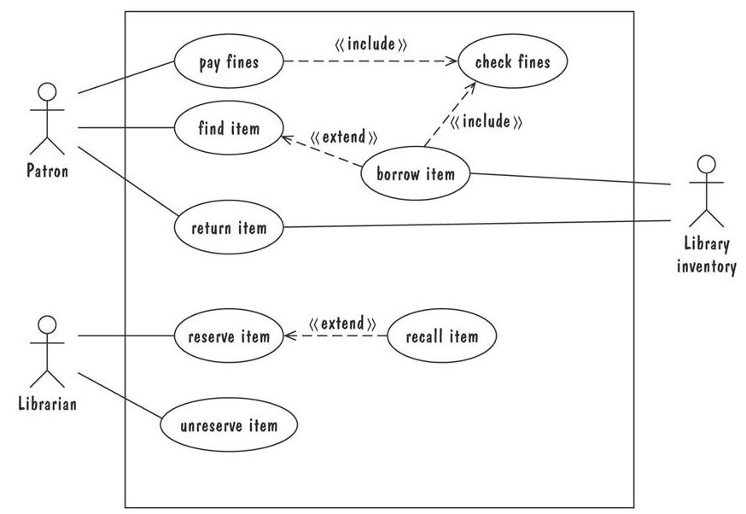
Use Case Diagram (Recap)
Library use cases including borrowing a book, returning a borrowed book, and paying a library fine
Actors
Stereotype
Multiple scenarios

Slide 5
Sequence Diagram (Recap)
A graphical description of a sequence of events that are exchanged between real-world entities
Vertical line: the timeline of distinct entity, whose name appear at the top of the line
Horizontal line: an event or interaction between the two entities bounding the line
Time progresses from top to bottom
Each graph depicts a single trace, representing one of several possible behaviours
Traces have a semantic that is relatively precise, simple and easy to understand

Slide 6

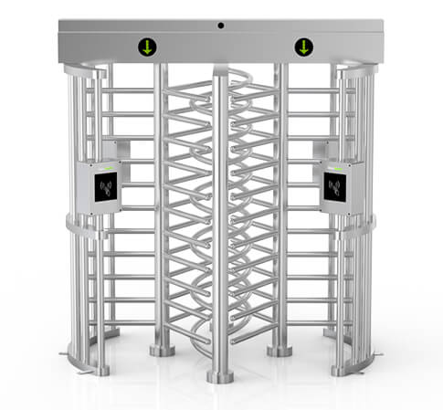
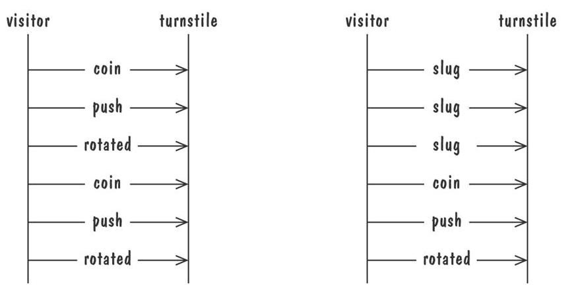
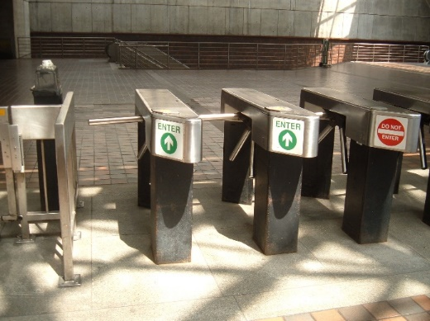
Sequence Diagram (Recap)
Graphical representation of two traces for the turnstile problem
trace on the left represents typical behaviour
trace on the right shows exceptional behaviour

Slide 7
State Diagram (Recap)
A graphical description of all dialog between the system and its environment
Node (state) represents a stable set of conditions that exists between event occurences
Edge (transition) represents a change in behavior or condition due to the occurrence of an event
Useful both for specifying dynamic behavior and for describing how behavior should change in response to the history of events that have already occurred

Slide 8
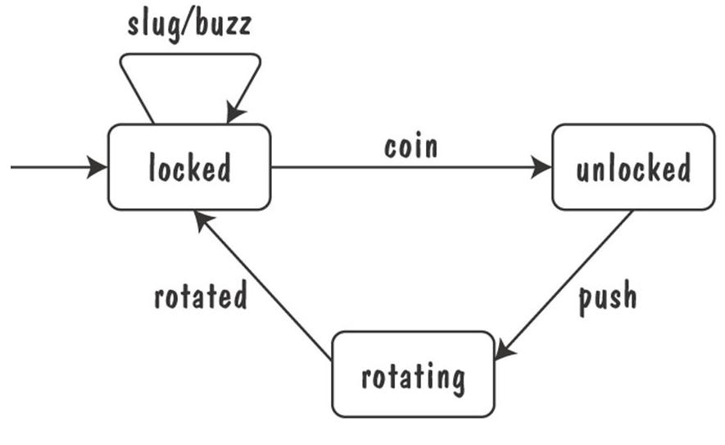
State Diagrams (Recap)
Finite state machine model of the tunstile problem

Slide 9
State Diagrams (Recap)
Ways of thinking about State
Periods of time between consecutive event
Named control points in an object's evolution
Partition of an object's behaviour

Slide 10
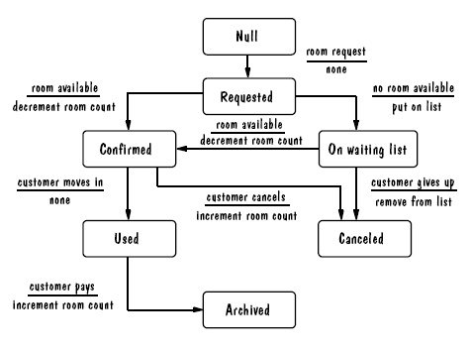
UML Statechart Diagram Example
The UML state diagram for Hotel Reservation

Slide 11
Activity Diagram (Recap)
Depicts behavior of the system
Dynamic aspects
Control flow from start to finish
Decision paths
Constraints and conditions
Notation
Start node
End node
Decision node
Activity
Control flow

Slide 12
Swimlane Diagram (Recap)
See document

Slide 13
Entity-Relationship (ER) Diagram (Recap)
A popular graphical notational paradigm for representing conceptual models
Has three core constructs
An entity: depicted as a rectangle, represents a collection of real-world objects that have common properties
A relationship: depicted as an edge between two entities, with diamond in the middle of the edge specifying the type of relationship
An attribute: an annotation on an entity that describes data or properties associated with the entity

Slide 14
ER Diagram
ER diagrams are popular because
they provide an overview of the problem to be addressed
the view is relatively stable when changes are made to the problem's requirements
ER diagram is likely to be used to model a problem early in the requirements process

Slide 15
Example
We need to develop an HR Information System (HRIS) which keeps records of all employees and allows the HR Manager to keep record of leave applications. Employees can apply three types of leaves (Short, Casual, Earned). Each leave requires the Employee with an Employee Id to enter Start and End Date, Start and End Time of leave, and a reason for the leave application. Once this information is entered, the leave application is Submitted. System also records the date and time of application submission. The Submitted applications can either be Accepted or Rejected by HR managers. The HRIS records the ID of the HR manager who has approved/rejected the leave application alongwith the comments of the HR manager against an application. The HRIS keeps record of all the leaves and shall generate a report of accepted, rejected, or total leaves of an employee. HR Managers cannot apply for the leave using the HRIS though.

Slide 16
Exercise
We need to develop a computerized quiz system. The system allows creation and grading of quizzes. The number of questions in a quiz are different. Each question has variable number of options. Each question can carry different marks. The system keeps grading each question during the quiz and shows the final score once the quiz is complete. During a quiz, the questions are shown one by one. Each question may be solved in different amount of time. If a question remains un-attempted and the time allowed for the question expires, next question appears. Percentage of negative marking (0% to 50%) for each quiz can also be specified. Separate quizzes with questions having descriptive answers can also be created. Such quizzes are checked by the creator and not by the system.
Express these requirements using Entity-Relationship (ER) diagram. In an ER diagram entities are represented as rectangles, attributes are shown in ovals and relationships between entities are represented by diamonds.

Slide 17
Class Diagram (Recap)
A Class Diagram represents a system in terms of
objects: akin to entities, organized in classes that have an inheritance hierarchy
attributes: object's variables or characteristics
behaviours: actions on the object's variables

Slide 18
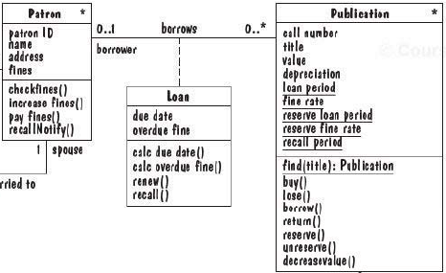
Class Diagram (Recap)
Class
Class Name
Association
Attributes
Behaviours

Slide 19
Identifying classes
External Entities (producers, consumers)
Things
Occurrences or events
Roles
Organizational Units
Places
Structures

